Slide 1
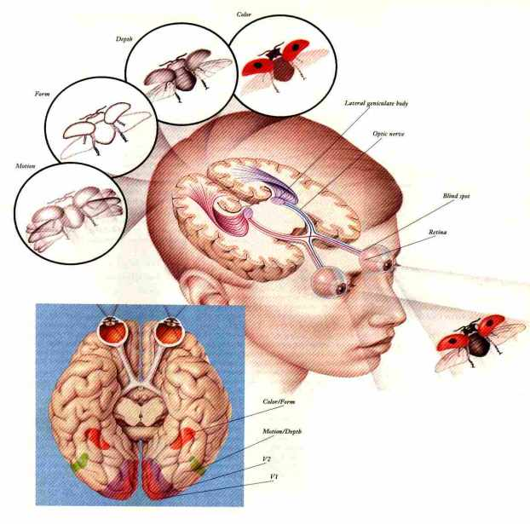
Human Eye
The eye is an extension of the brain
Source: www.pptpoint.om

Slide 2
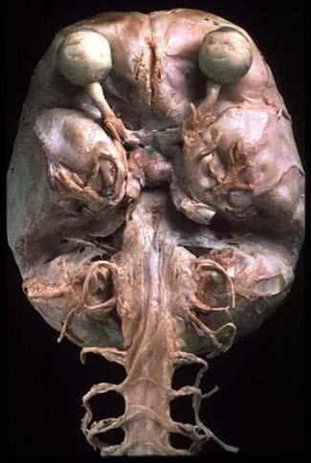
Eye brain proxomity
Can you see :
the optic nerve bundle?
Spinal cord?
Source: www.pptpoint.om

Slide 3
Human Eye
A human eyeball is like a simple camera!
Sclera: outer walls, hard, like a light-tight box.
Cornea and crystalline lens (eyelens): the two lens system.
Retina: at the back of eyeball, like the film.
Iris: like diaphragms or stop in a camera.
Pupil: camera aperture.
Eyelid: lens cover.

Slide 4
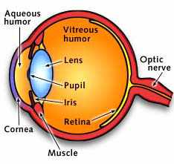
Cross section
Retina
Lens
Cornea
Optic nerve
Cilary muscles
Source: www.pptpoint.om

Slide 5
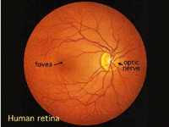
Retina – receives the image
Full of light receptors which are sensitive to:
Colour
Light levels
Massive blood supply is also needed
Fovea is the main focal point and has greatest density of light receptors
Source: www.pptpoint.om

Slide 6
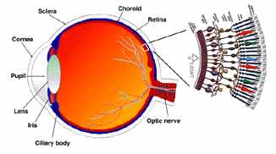
Retina receptors
Light receptors are called rods and cone
Source: www.pptpoint.om

Slide 7
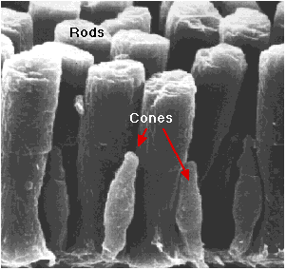

Slide 8
Rods and Cones
Covers an area of 5 cm². A baseball a mile away gives an image covering one cone.
Cones: for more precise vision, need strong light. help to see colors. Mostly distributed in the center of the retina (fovea).
Rods: for peripheral and night vision. Sensitive to light. Mostly distributed away from fovea.

Slide 9
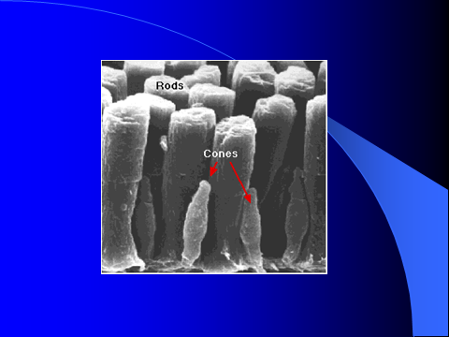
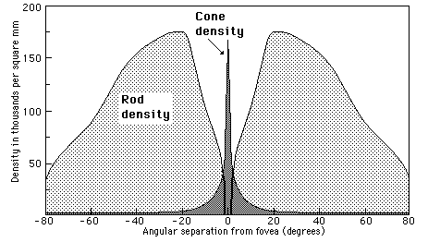

Slide 10
Sensitivity
Cones: slow, fine grain, like color film.
Need high level of light
High density, high resolution.
Rods: fast, coarse grain, black & white film
Low level of light
No color is obvious.

Slide 11
Accommodation
The eye focusing is not done by change the distance between the lens and retina. Rather, it is done by changing the focal length of the eyelens! Ciliary muscles help to change the shape of the lens: accommodation.
Muscles relax, long focal length, see objects far way; Muscles tense, short focal length see objects close.
Normal eyes can see 25cm to infinity, however, if the cornea bulges too much or too little. The accommodation does not help. (myopia or hyperopia)

Slide 12
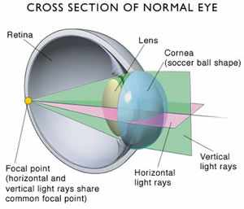
Focusing on objects
The lens and cornea focus the light on the retina
Source: www.pptpoint.om

Slide 13
Focusing
The cornea and eyelens form a compound lens system, producing a real inverted image on the retina.
From air to cornea (n=1.376): large bending, the main focusing.
From cornea to eyelens (n=1.406), less focusing power. (Eyelens can develop white cloudiness when getting old: Cataracts.)
The eye has a limited depth of field. We cannot see things close and far at the same time.

Slide 14
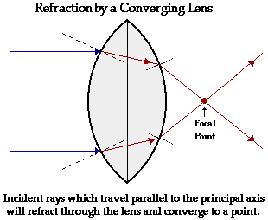
Bending light
Light is refracted and bent to focus it as it passes through the lens
Lens thickness can be changed so the amount of bending is changed
Source: www.pptpoint.om

Slide 15
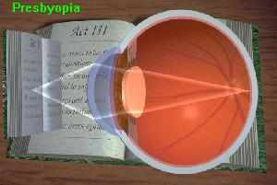
Near vision
to bend the light more to focus it
Fat lens needed
Source: www.pptpoint.om

Slide 16
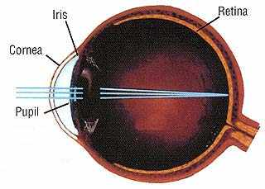
Distance vision
Rays enter the eye closer together
Need less bending
Thinner lens needed
Source: www.pptpoint.om

Slide 17
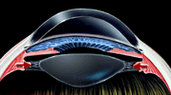
Changing lens thickness
The lens is slightly elastic, its relaxed state is short and fat.
Cilary muscles are attached to the lens, when contracted they pull the lens thin
Source: www.pptpoint.om

Slide 18
The Iris
When it is full open, it is about f/2 and f/3. This happens at low light level.
When the iris has a small opening, it can cut down the light intensity by a factor of 20.
However, the main function of stopping down the iris is to increase the depth of field.

Slide 19
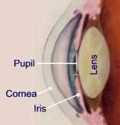
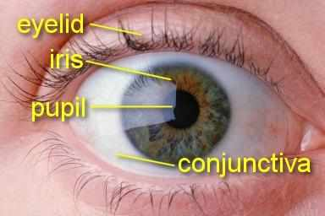
Controlling light levels
Your eye are very sensitive and can be damaged by harsh light.
Your iris controls light allowed into the eye by changing the size of the pupil
Source: www.pptpoint.om

Slide 20
Processing Time
Latency: it takes a bit time for the cells in retina to respond to a flash of light.
Persistence of response: the response does not stop at the instant the flash stops.
1/25 second at low intensity, 1/50 second at high intensity.
The persistence allows as to see moving things clearly.

Slide 21
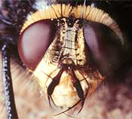
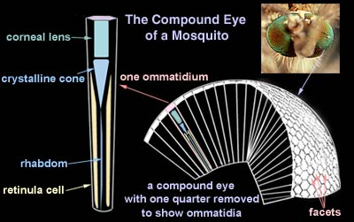
Insect Eye
We make cameras that act “similar” to the human eye
Fly
Mosquito

Slide 22
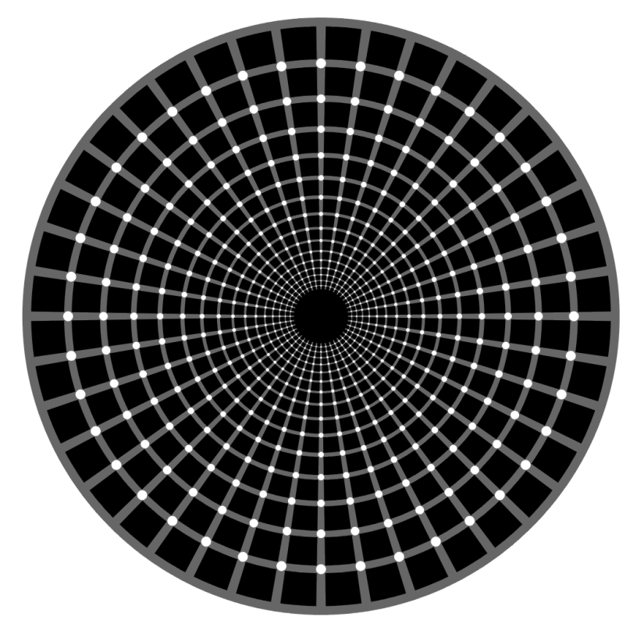
Understanding Optical Illusions
The set of illusion slides presented below is from Mohit Gupta (Columbia)
Notes:
The whole talk is very exploratory – as is the topic itself. For most of these illusions, there is no definite consensus on why these happen. There are a lot of theories and counter-theories – in a series of papers. There have been PhD theses on single optical illusions too.

Slide 23
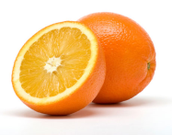

What are optical illusions?
Perception: I see
Light (Sensing)
Truth: But this is an !
Source: Mohit Gupta
Oracle
Notes:
When I started preparing this presentation, I thought I could show a lot of different classes of illusions. Then, I started reading about them in detail – and I thought that maybe I could talk about only one class – as there is so much interesting stuff behind each class of illusions. Then I discovered that people have done PhD theses on a single illusion! There are illusions over which a series of papers have been published making claims and then counter-claims as to why they happen. And these are serious papers – in Nature and Vision Research and Psychology.
So – I will mostly talk about the luminance and contrast illusions today – and try to understand the reason behind them.

Slide 24
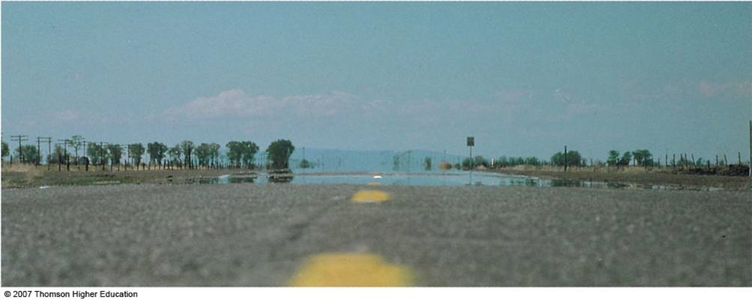
Optical Illusion in Nature
Source: Mohit Gupta
Image Courtesy: http://apollo.lsc.vsc.edu/classes/met130/notes/chapter19/graphics/infer_mirage_road.jpg

Slide 25
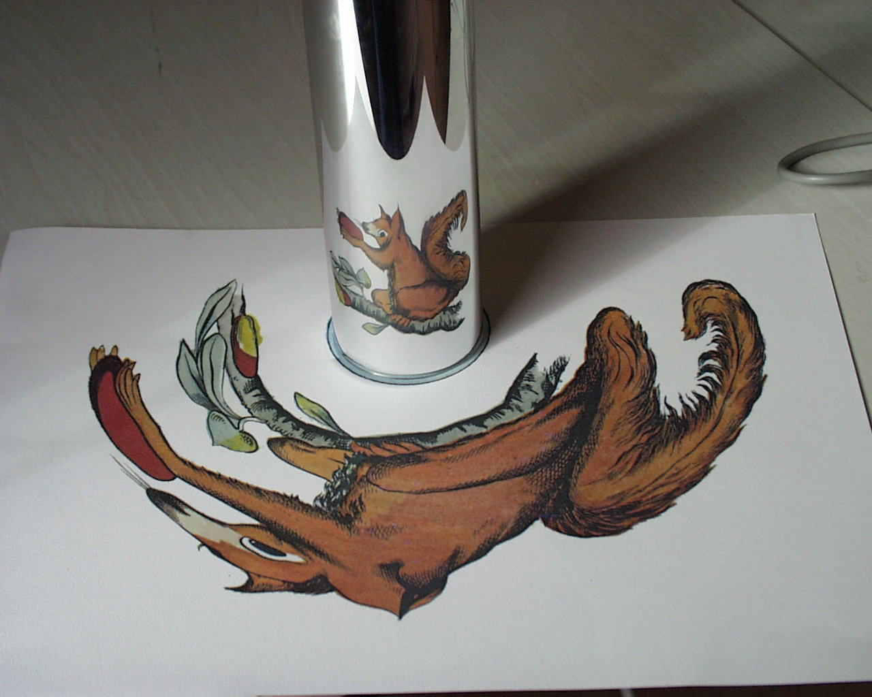
Anamorphoses

Slide 26
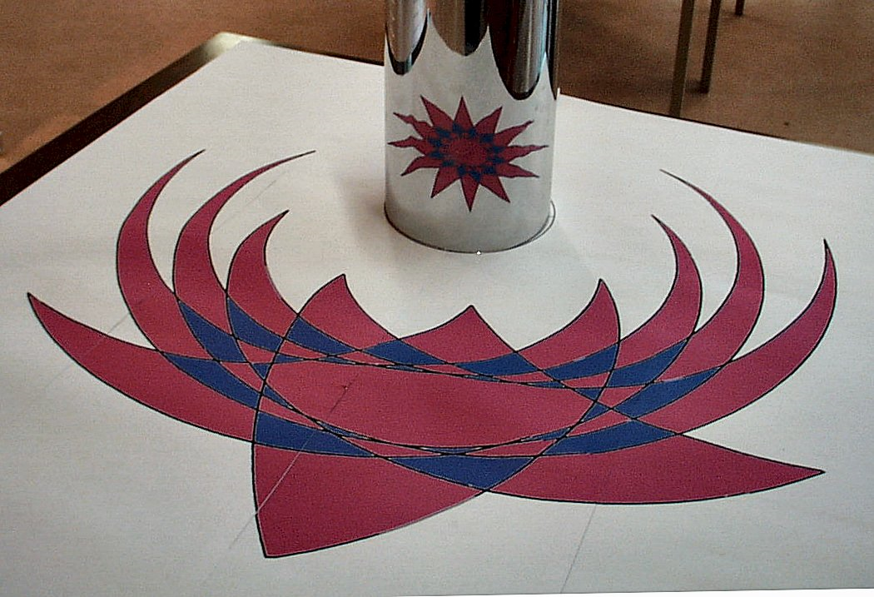
Source: Mohit Gupta

Slide 27
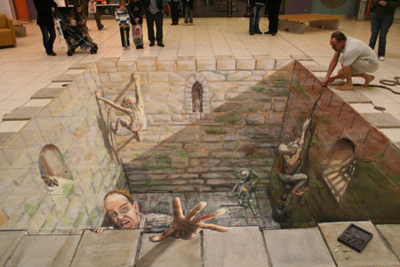
Source: Mohit Gupta

Slide 28

A Brightness Illusion
Source: Mohit Gupta

Slide 29
Different kinds of illusions
Brightness and Contrast Illusions
Twisted Cord Illusions
Color Illusions
Perspective Illusions
Relative Motion Illusions
Illusions of Expressions
Source: Mohit Gupta

Slide 30
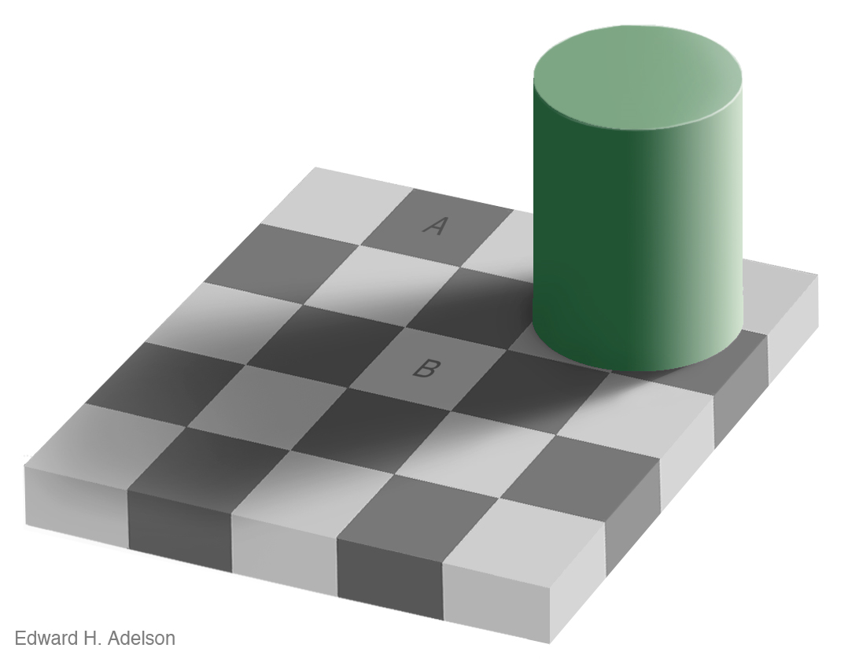
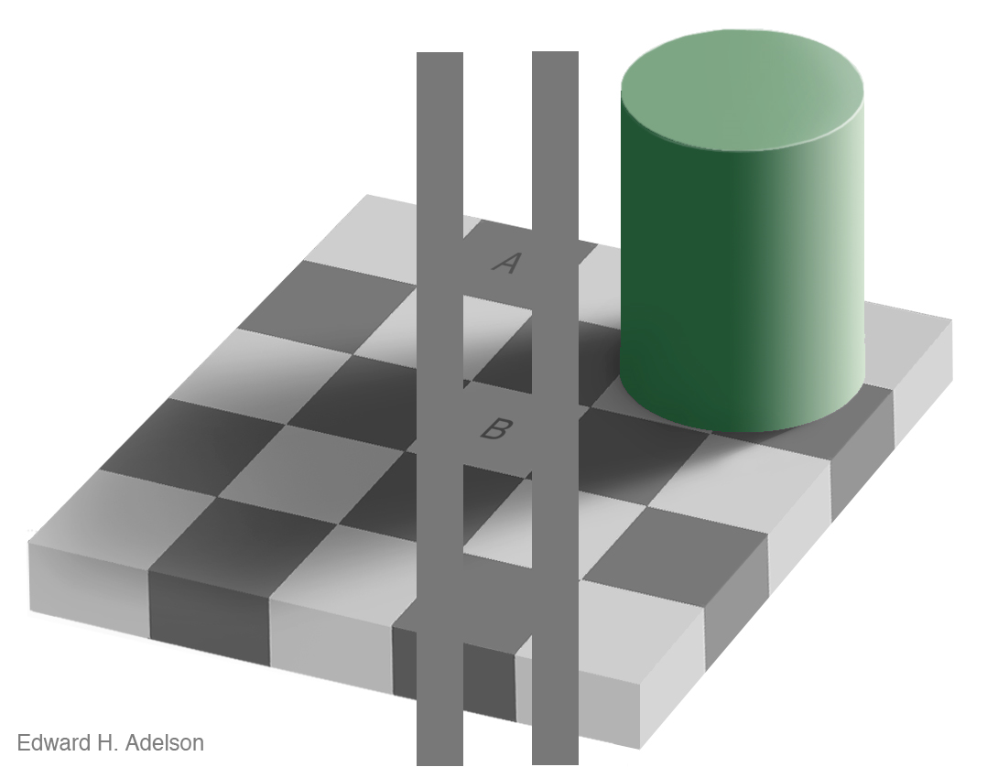
Lightness Constancy
Our Vision System tries to compensate for differences in illumination

Slide 31

Simultaneous Contrast Illusions
Notes:
Difference between lightness and intensity.
Low level: Explain lateral inhibition here – show the cells etc.
High level: Lightness constancy
http://www.nku.edu/~issues/illusions/LateralInhibition.htm
Two levels of explanations: Low level and high-level

Slide 32
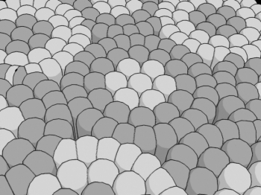
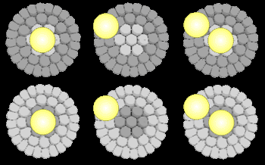
Low-level Vision Explanation
Negative Photo-receptors
Positive Photo-receptors
Receptive Fields in the Retina
-
Inhibitory Light
-
+
-
Excitatory Light
-
Notes:
Why do we have this kind of structure? Why are we responsive to gradients as rather than absolute values? Reflectance and illumination edges.

Slide 33
Low-level Vision Explanation
-
-
-
+
-
-
+
-
-
-
Positive Gradient
Negative Gradient

Slide 34
High-level Vision Explanation: Context
Less Incident Illumination
More Incident Illumination
Higher Perceived Reflectance
Lower Perceived Reflectance
Brightness = Reflectance * Incident Illumination
Notes:
Context – lightness constancy is at work here. From the context, our brain thinks that the left part of the image is getting less light as compared to the right part of the image. Our brain then tries to compensates for the effect of the lighting. So, even though the intensity of the bar is the same, the brain thinks that the reflectance of the left part is higher.

Slide 35
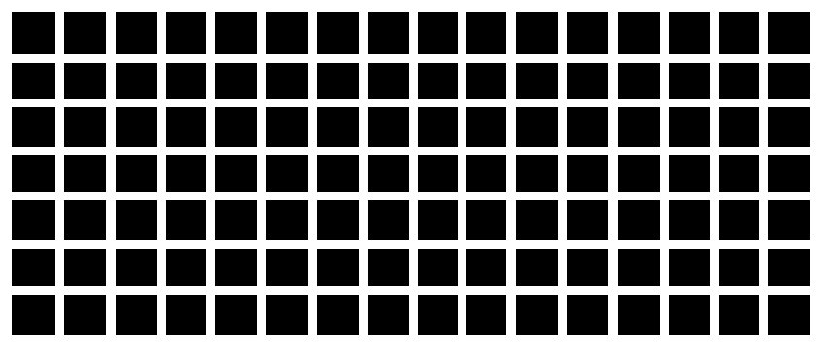
The Hermann grid illusion
Notes:
non-existent smudges seen at the intersections except at the center of gaze.

Slide 36
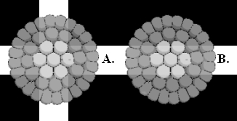
The Hermann grid: Low level Explanation
-
-
+
-
-
Lateral Inhibition

Slide 37
The Hermann grid illusion
Focus on one intersection
Notes:
non-existent smudges seen at the intersections except at the center of gaze.

Slide 38
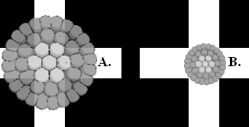

Why does the illusion disappear?
Receptive fields are smaller near the fovea (center) of the eye

Slide 39
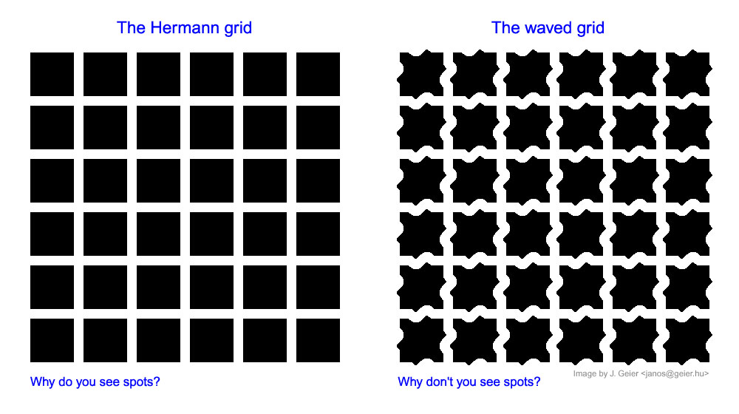
The Waved Grid: No illusion!

Slide 40
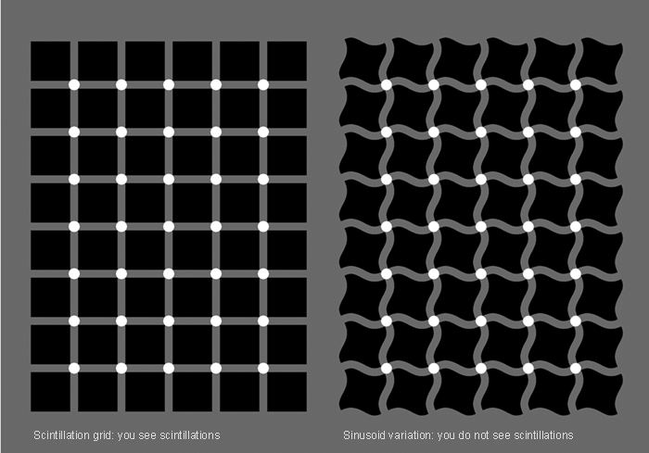
Scintillating Grids: Straight and Curved
Notes:
So, even though the low-level explanation is good to explain a lot effects – it can not explain all of them.
There are many effects which a high-level explanation can not explain.
Ideally, what we want is a unified theory of vision – which can explain all the effects – much like a unified theory for physics.

Slide 41
Adelson’s checkerboard illusion
Notes:
I think of optical illusions as similar to active illumination – with active illumination, we probe the scene for more properties. With optical illusions, we probe the vision system itself for more properties.
We can learn only so much by observing the system working fine – we can probably learn more by seeing where they fail. In normal scenarios, the visual perception mechanisms are hidden – by forcing the system into an odd situation by using these specially constructed stimuli, we can learn more.

Slide 42
Adelson’s checkerboard illusion

Slide 43
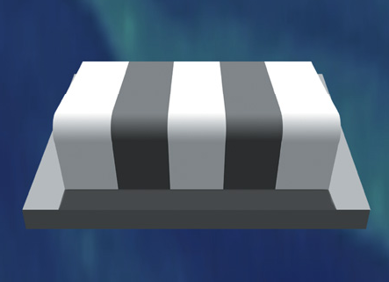
Where is the illusion?
Notes:
Todorovic’s Gradient Chessboard Illusion.

Slide 44
Where is the illusion?
Notes:
Todorovic’s Gradient Chessboard Illusion.

Slide 45
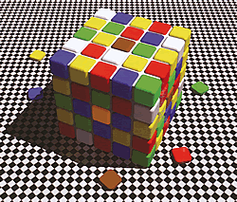
Rubik’s Cube Color Illusion
Same Color?

Slide 46
Rubik’s Cube Color Illusion
Notes:
This is one of the most powerful color illusions known – I will flip back and forth – I know that I am being fooled, but I still can’t believe it. Once again – the role of context and past experience comes into play here. We can see that one face is in shadow – and our vision system tries to compensate for it.

Slide 47

Craik-O’Brien-Cornsweet Illusion
Actual Profile
Perceived Profile

Slide 48
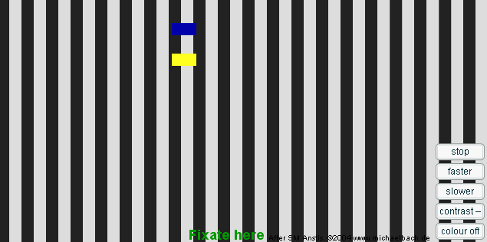
Footstep Illusion
Contrast affecting Perception of speed
Click
Notes:
The perception of speed is low in low contrast conditions. In bad weather conditions, such as fog – people actually tend to drive faster! This is a study published in Nature. This is because the perceived speed is low.
But there is more to this illusion than just the connection of speed perception and contrast.
We see these because of contributions of edges (leading and lateral) and background edges – their relative contributions to the perception of speed. This is the basic theory – there have been a series of papers on this particular illusion which provide alternate theories or add to this theory. The reason I wanted to show this illusion was that it shows the dramatic effect the background can have on perception of both the speed and position of an object.

Slide 49
Twisted Cord Illusions

Slide 50
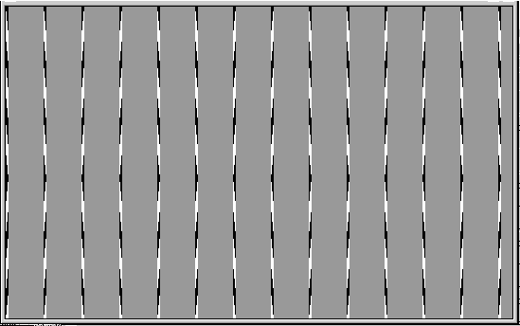
Are the lines parallel? Straight?
Notes:
Twisted Cord Illusion

Slide 51
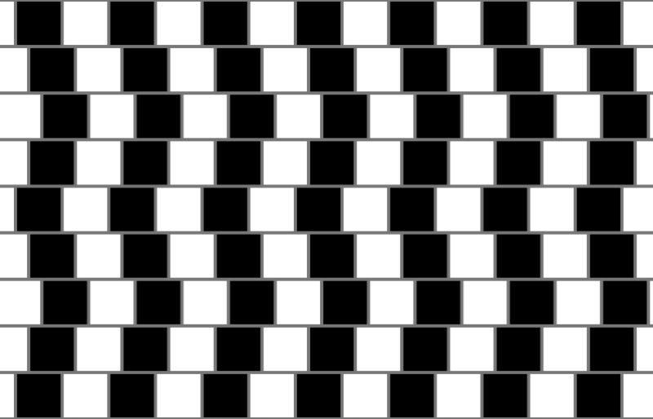
Café Wall Illusion

Slide 52
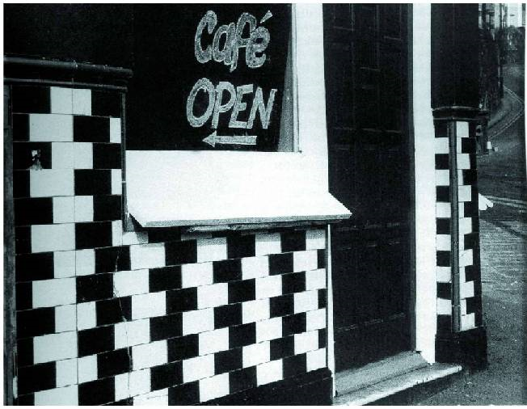
Café Wall Illusion

Slide 53
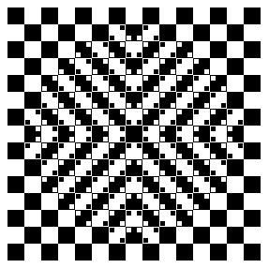
A variant of the Café Wall Illusion

Slide 54
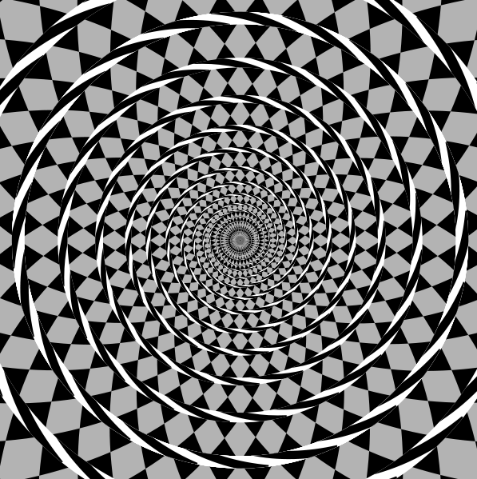
The Fraser Spiral Illusion
Notes:
This is an extremely strong illusion. When people trace it with their fingers, they go down a spiral – so they really believe it is a spiral.

Slide 55
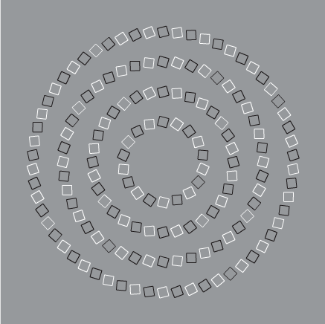
Pinna’s Intertwining Illusion

Slide 56
Illusions involving perspective

Slide 57
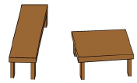
Shepard’s table-top illusion
Which is bigger?

Slide 58
Shepard’s table-top illusion
Which is bigger?

Slide 59
Shadow Illusions

Slide 60
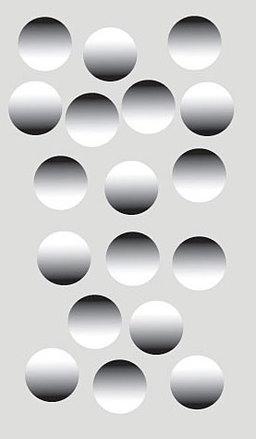
Shape-from-Shading
Shadows influence the perception of shape
http://www.nature.com/index.html?file=/neuro/journal/v1/n3/full/nn0798_183.html

Slide 61
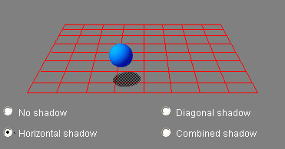
Kersten’s Ball and Shadow Illusion
Click
Shadows influence the perception of motion and position

Slide 62
Relative Motion Illusions
Notes:
Our perceptual system needs to be able to detect motion quite reliably. Over the years, there have been a lot of artists or vision scientists who have created still images which stimulate the areas of brain corresponding to motion. This results in an illusory sense of motion from still images.

Slide 63
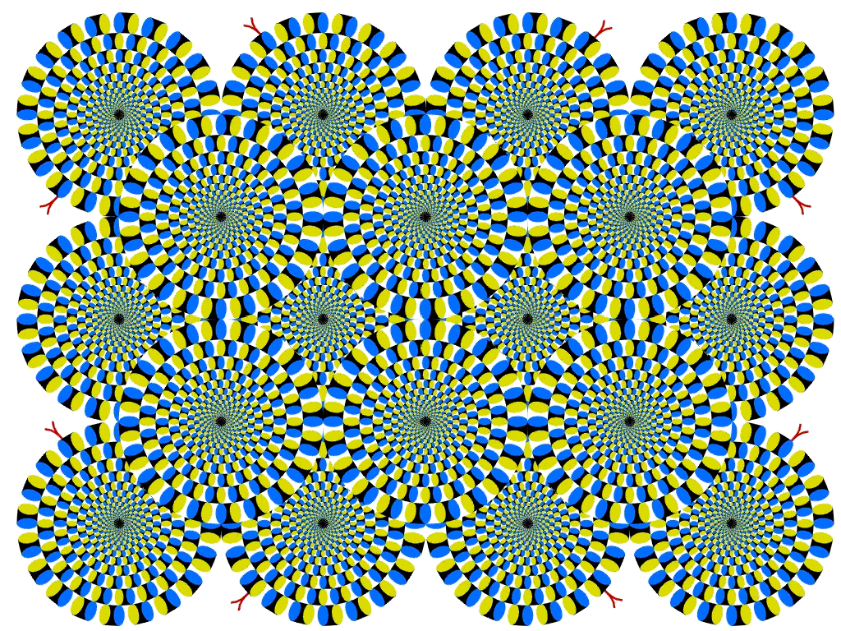
Spinning Wheel Illusion
Notes:
Why does this happen? What is this in this image which is stimulating the motion areas of the brain – thinking about this can help us understand the perception of motion.

Slide 64
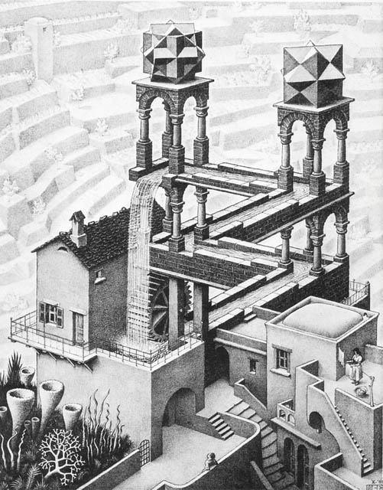
Have fun with Optical Illusions
Escher’s Waterfall
Then think about them!

